Slide 1
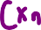

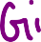
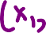














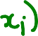

Slide 2
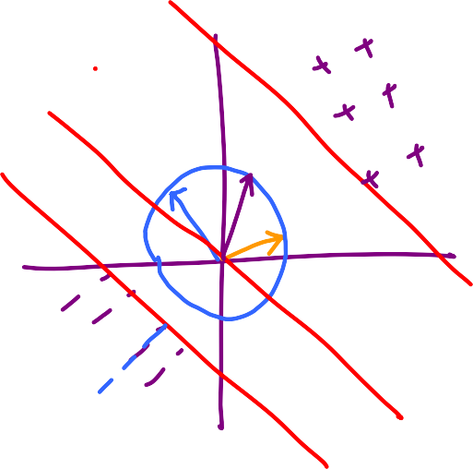

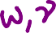
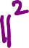

Slide 5
x₂
[0.5 2.5]
[1/3 1/3]
[1 1]
x₁
x₁ + x₂ = 3
(1/3)x₁ + (1/3)x₂ = 1
[-0.5 -2.5]
x₁ + x₂ = -3
(1/3)x₁ + (1/3)x₂ = -1

Slide 6
x₂
[0.5 2.5]
x₁ = -0.5
(2)x₁ = -1
[1 0]
x₁
[2 0]
x₁ = 0.5
(2)x₁ = 1
[-0.5 -2.5]

Slide 7
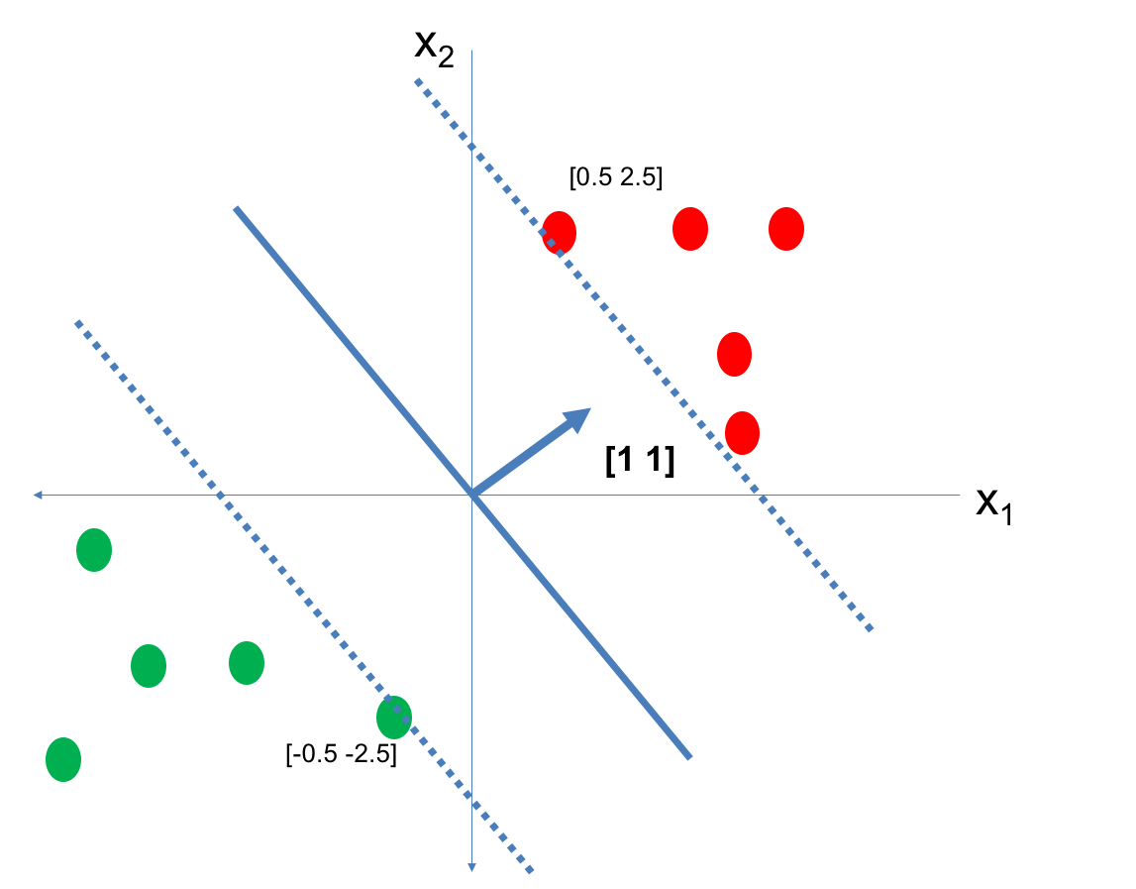
Notice what happens
to the lengths
of the w as we
adjust it to have
margin 1

Slide 8



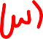

OBSERVATIONS
-> Once a direction is fixed,
the width between the margin lines
is fixed
-> If the width is large, then the w that
achieves margin 1 in that direction
has smaller length
-> If the width is small, then the w that
achieves margin 1 in that direction
has larger length
-> In general, width(w) seems to be
inversely proportional to length(w)

Slide 9

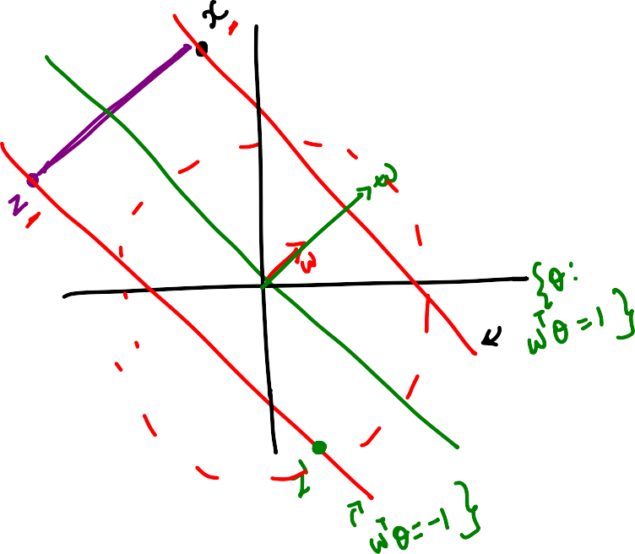
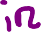

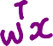


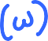


Slide 10
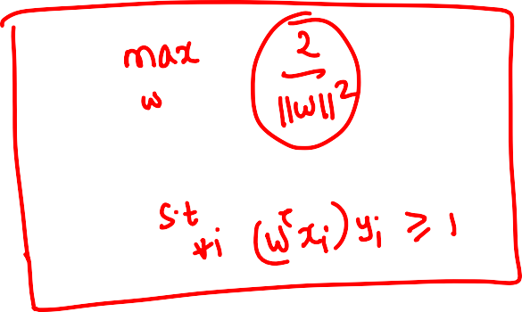

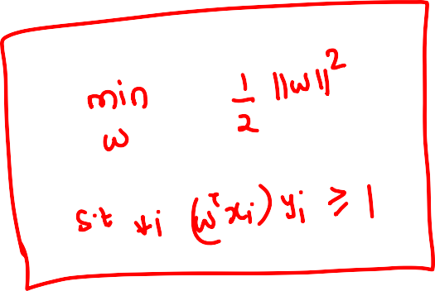


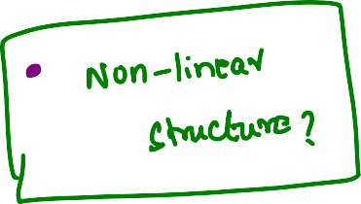

Slide 11

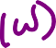
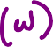

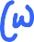
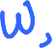




Slide 12




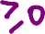
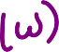
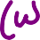


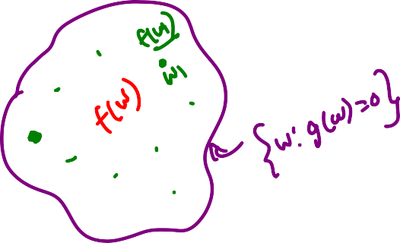


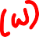

Slide 13
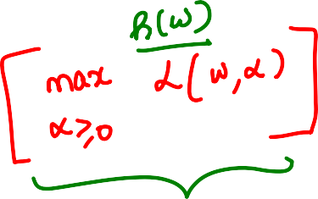


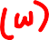


Slide 14
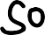
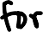
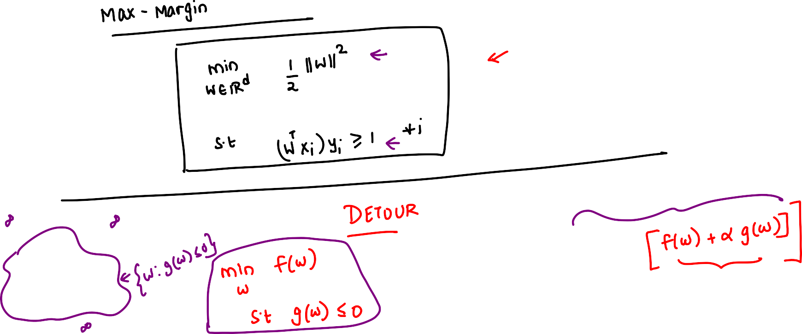

Slide 15
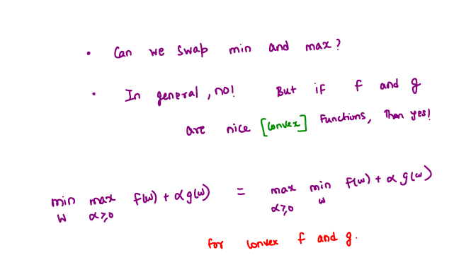

Slide 16



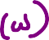
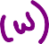

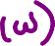
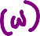



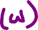
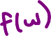
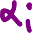

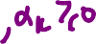

Slide 17
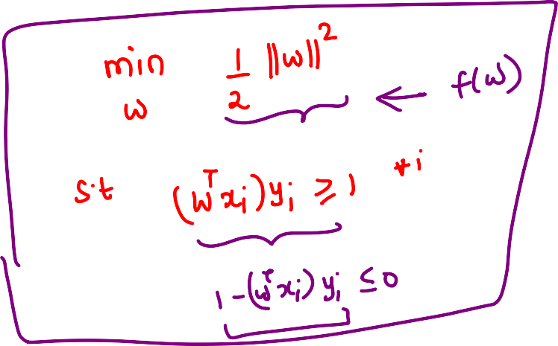
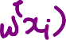
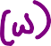




Slide 18
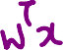



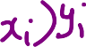
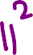





Slide 19
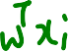
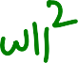



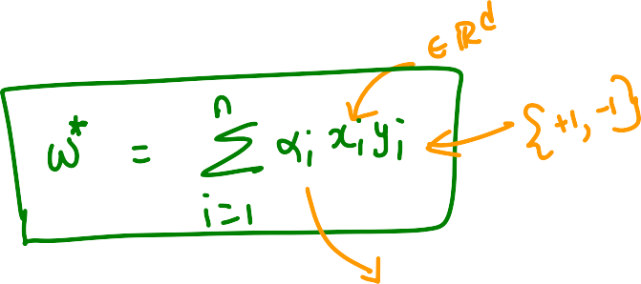



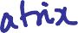



Slide 20
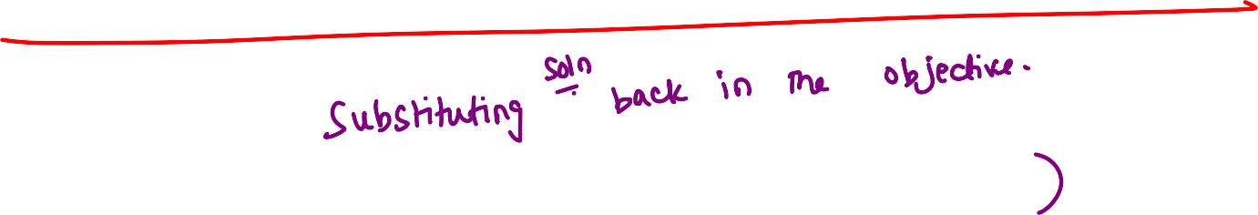







Slide 21
















Slide 22











Slide 23
















Slide 24















Slide 26
So far
Support Vector Machines
Primal Problem – Margin Maximization
Dual Problem
- Kernel Version
Now
- What if there are outliers in the problem?

Slide 27















Slide 28






















Slide 29
















Slide 30











Slide 31









Slide 32









Slide 33



Slide 34














Slide 35













Slide 36















Slide 37



















Slide 38
















Slide 39















Slide 41


Slide 42





Slide 43




Slide 44



Slide 45




Slide 46





Slide 47



Slide 48



Slide 49














Slide 51





Weak classifiers
Overfit decision tree
…
high bias, low variance
……………
low bias, high variance

Slide 52












Overfit
decision trees

Slide 53



















Chance that a point
appears in a
dataset

Slide 54










Feature bagged decision trees -> RANDOM FOREST

Slide 55

















Slide 56






















Slide 57
x₂
[0.5 2.5]
[1/3 1/3]
[1 1]
x₁
x₁ + x₂ = 3
(1/3)x₁ + (1/3)x₂ = 1
[-0.5 -2.5]
x₁ + x₂ = -3
(1/3)x₁ + (1/3)x₂ = -1

Slide 58
x₂
[0.5 2.5]
x₁ = -0.5
(2)x₁ = -1
[1 0]
x₁
[2 0]
x₁ = 0.5
(2)x₁ = 1
[-0.5 -2.5]

Slide 59
Notice what happens
to the lengths
of the w as we
adjust it to have
margin 1

Slide 60
OBSERVATIONS
-> Once a direction is fixed,
the width between the margin lines
is fixed
-> If the width is large, then the w that
achieves margin 1 in that direction
has smaller length
-> If the width is small, then the w that
achieves margin 1 in that direction
has larger length
-> In general, width(w) seems to be
inversely proportional to length(w)

Slide 78
So far
Support Vector Machines
Primal Problem – Margin Maximization
Dual Problem
- Kernel Version
Now
- What if there are outliers in the problem?

Slide 103
Weak classifiers
Overfit decision tree
…
high bias, low variance
……………
low bias, high variance

Slide 104
Overfit
decision trees

Slide 105
Chance that a point
appears in a
dataset

Slide 106
Feature bagged decision trees -> RANDOM FOREST

Slide 109




















Slide 110





















Slide 111














Slide 112



















Slide 113













Slide 114












Slide 115














Slide 116
















Slide 117















Slide 118














Slide 119


















Cannot run in parallel – hence sometimes bagging is preferred in practice
Usually weak learners are decision stumps -> high bias, low variance
Boosting reduces bias without affecting variance a lot

Slide 121
Why are there so many binary classification algorithms?

Slide 122





NP-Hard problem

Slide 123













Linear Regression for
classification
Final classifier:
Loss per point for h

Slide 124



Slide 125













SUPPORT VECTOR MACHINES
Equivalently
Equivalently

Slide 126


Equivalently,
Model
Regularization
term
Data
Loss
term
So what exactly is the loss?
HINGE LOSS

Slide 127



Hinge
Courtesy: Google images

Slide 128







Slide 129



Slide 130





Loss for a single point when z_{i} = 1 (y_{i} = 1)
Loss for a single point when z_{i} = 0 (y_{i} = -1)

Slide 131




Slide 132


Slide 133




Slide 134


Slide 135


BOOSTING

Slide 136



Slide 137


Slide 138






























What about Peceptron and Boosting?

Slide 139

SUMMARY
0-1
Exponential
Logistic
Squared
Hinge
-> The 0-1 loss is NP-hard
to optimize even for linear
classifiers
-> Different algorithms
get around this by using a
“surrogate” loss function
-> Surrogates are usually
“convex” surrogates
that are easy to optimize
loss(h(x),y)
h(x).y

